Slide 1


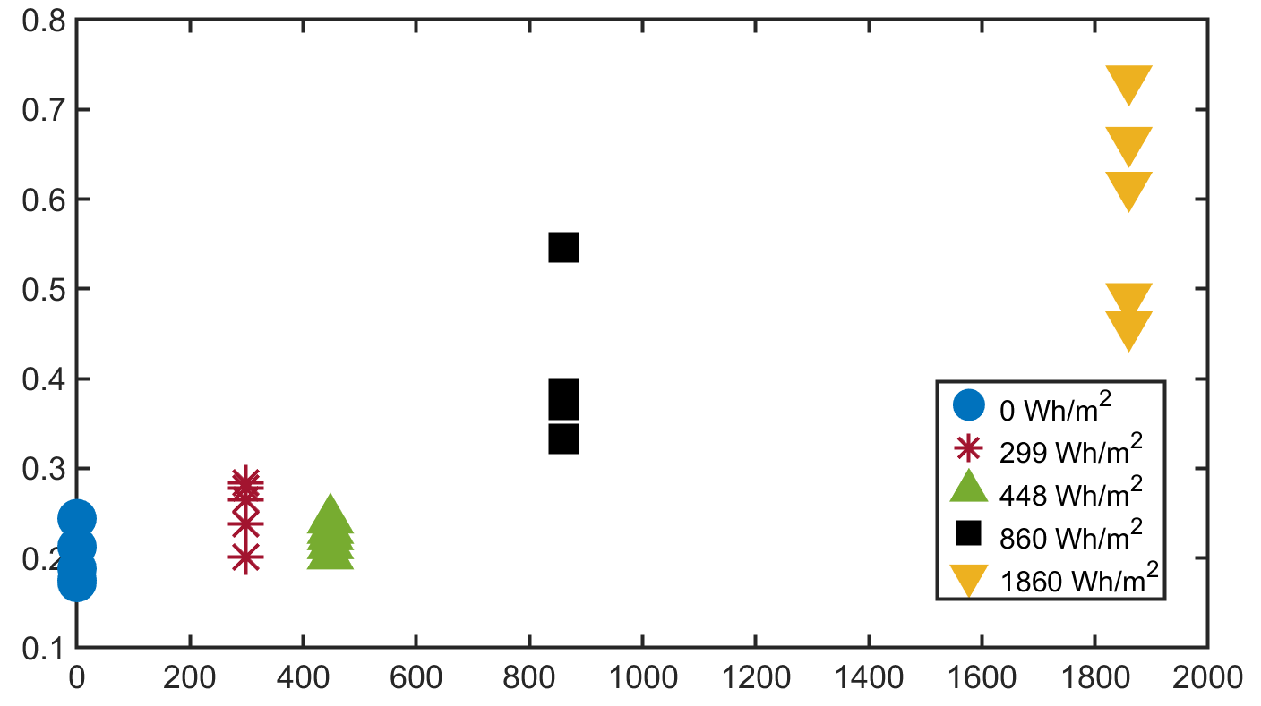

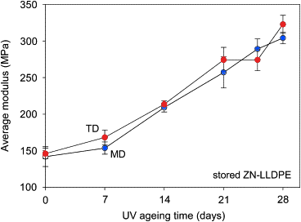
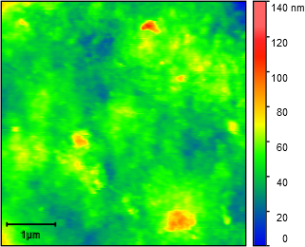
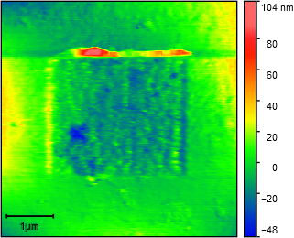
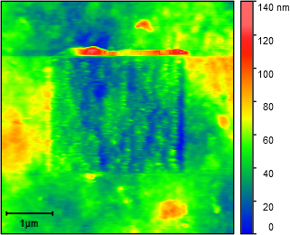
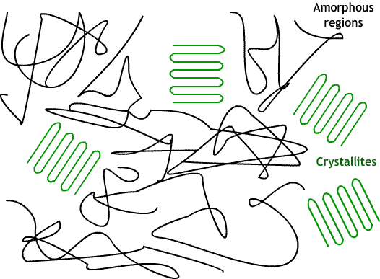
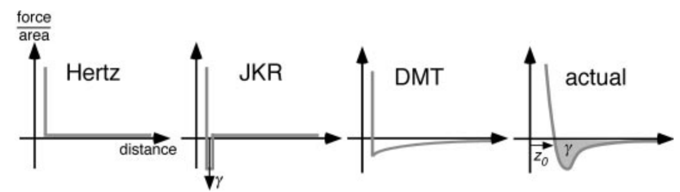
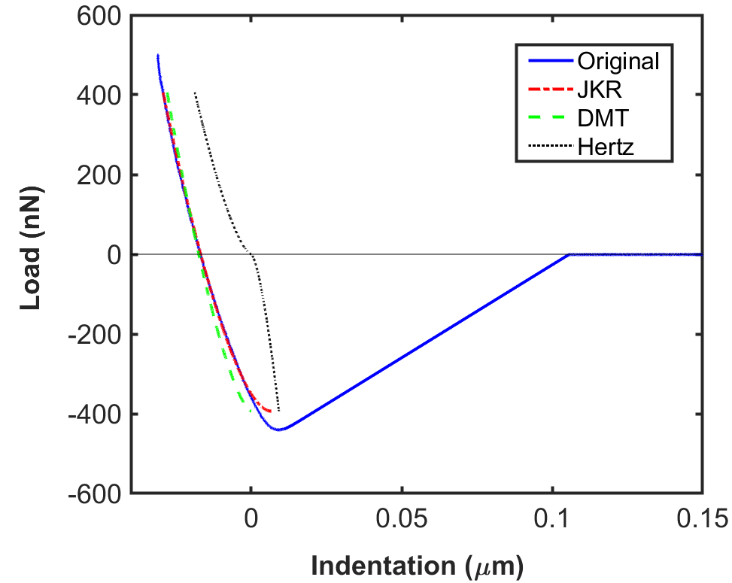
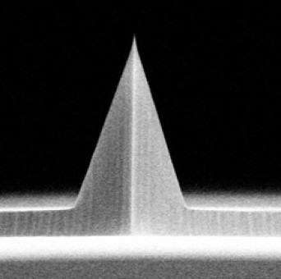
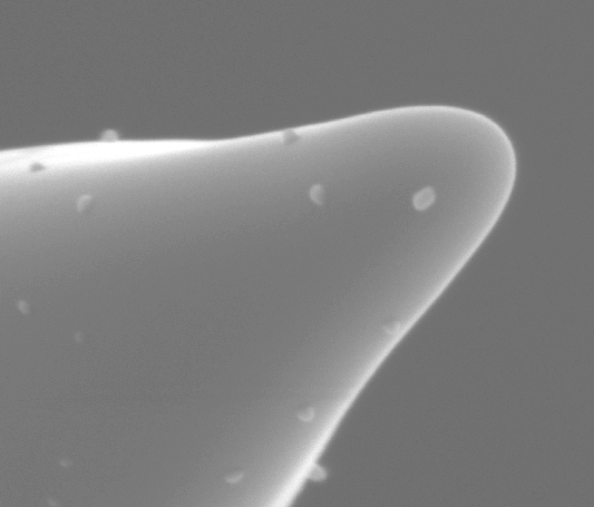


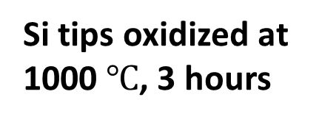
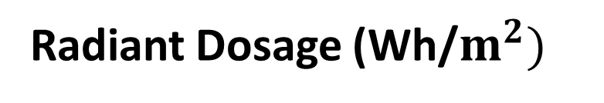

Surface Mechanical Properties of Photo-Weathered Low-Density Polyethylene on Microplastic Generation
Stacy Godfreey-Igwe*, Sara BinAhmed-Menzies**, Boya Xiong**
*Department of Mechanical Engineering, MIT
**Department of Civil, Environmental, Geo-Engineering, University of Minnesota
Overview
Results
Around 300 million tons of plastic are produced annually; more than 80% end up polluting our air, terrestrial, and aquatic environments [1]. Partial degradation of plastics is considered the major source of microplastics, which pose a threat to many forms of life. We hypothesize that mechanical abrasion of photo-weathered plastics at their surface is a dominant mechanism in generating smaller plastic fragments. We utilize atomic force microscopy (AFM) and nanoindentation to analyze the changes to surface mechanical properties of commercial low-density polyethylene (LDPE) samples as the material is weathered by UV radiation.
Fig. 6 Young’s Modulus of LDPE as calculated by MATLAB code over the radiant dosage (constant 340 nm UV over time). We observed increasing elastic modulus E as UV exposure increases. As hypothesized, modulus change in response to irradiation is similar between bulk scale and surface nano-scale.
E of LDPE (GPa)
Background
In the natural environment, semi-crystalline polyethylene undergoes a series of molecular and structural changes. In the presence of oxygen and sunlight, free radicals induce chain scission in the polyethylene’s amorphous domain; creating shorter and more polymer mobile chains that form new crystalline structures over time. Many studies are focused on bulk mechanical property measurements (Fig. 2), while our research focuses on surface mechanical properties of photo-weathered plastics.
Radiant Dosage (Wh/$m^{2})$
Calculating Abrasion Volume Difference:
Before:
-
After:
Volume Difference:
UV irradiation
=
Machine Direction
Transverse Direction
Fig. 7 Topographical images from AFM depicting 9 $μ$m² area of virgin LDPE surface before and after abrasion experimentation. Through imaging software, the pre & post abrasion images were subtracted in order to calculate the loss of plastic material, which is correlated with nano & microplastic generation.
Increasing Photo-Weathering Time
Fig. 2 Average bulk ZN-LLPE modulus of elasticity over UV aging time indicating stiffness [2].
Experimental Methods
Future Work
Indentation:
MATLAB Execution of Contact mechanics model
We need to determine the threshold force load from abrasion experiments that begins to produce wear (i.e., plastic fragments).
Compare abrasion volume of photo-weathered LDPE to virgin samples.
Correlate indentation experiment modulus of elasticity with abrasion volume loss.
Force (nN)
References
[1] Geyer, R., Jambeck, J. R., and Law, K. L. (2017). “Production, use, and fate of all plastics ever made.” Science Advances, American Association for the Advancement of Science, 3(7), e1700782
[2] Hsu, Y.-C., Weir, M. P., Truss, R. W., Garvey, C. J., Nicholson, T. M., and Halley, P. J. (2012). “A fundamental study on photo-oxidative degradation of linear low density polyethylene films at embrittlement.” Polymer, 53(12), 2385–2393.
[3] Grierson, D. S., Flater, E. E., and Carpick, R. W. (2005). “Accounting for the JKR–DMT transition in adhesion and friction measurements with atomic force microscopy.” Journal of Adhesion Science and Technology, 19(3–5), 291–311
Tip radius: 880 nm
Loading rate: 500 nN
Inputs: Transition Parameter (λ), Radius, Poisson Ratio, E of tip
Output: E of Sample, Hardness
Indentation (𝜇m)
Fig. 4 Three contact mechanics models fitted to an original region of a retraction curve for virgin LDPE. In MATLAB, the JKR model produced the best fit with an E value of 87 MPa [3].
Abrasion:
Acknowledgements
Fig. 5A & 5B To simulate the size of environmental sediment, a more dull shape tip was prepared by oxidizing silicon tip. The original sharp tip was combusted to form a blunt silicon oxide tip after combustion for 3 hours at 1000°C.
I would like to give special thanks to Professor Boya Xiong and Dr. Sara BinAhmed-Menzies for supporting me throughout this research project. All of their efforts, in addition to the CSP coordinating team, made this summer research experience possible and gave me resources to find success in a future PhD program. Lastly, financial support was provided by the U.S. National Science Foundation Center for Sustainable Polymers, grant number CHE-1901635.
Si tips oxidized at 1000 $℃$, 3 hours

